Slide 1
Data modelling

Slide 2
Concurrency Control
Transaction
the basic unit of work in a DBMS
Properties of a transaction
ATOMICITY
CONSISTENCY
INDEPENDENCE
DURABILITY

Slide 3
A.C.I.D properties (1)
Atomicity
the is the “all or nothing” property ; a transaction is an indivisible unit of work
Consistency
transactions transform the DB from one consistent state to another consistence state

Slide 4
A.C.I.D properties (2)
Isolation / Independence
transactions execute independently of one another i.e. the partial effect of one transaction is not visible to other transactions.
Durability (aka Persistence)
the effect of a successfully completed (i.e. committed) transaction are permanently recorded in the DB and cannot be undone.

Slide 5
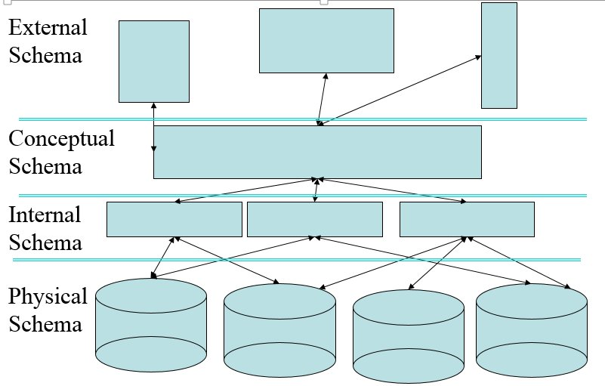
Why Relational?
ACID compliant
Atomic
Consistent
Isolated transactions
Durable(?)
Fully normalized, avoiding
Read anomalies
Update anomalies
Delete anomalies
Structured schemas

Slide 6



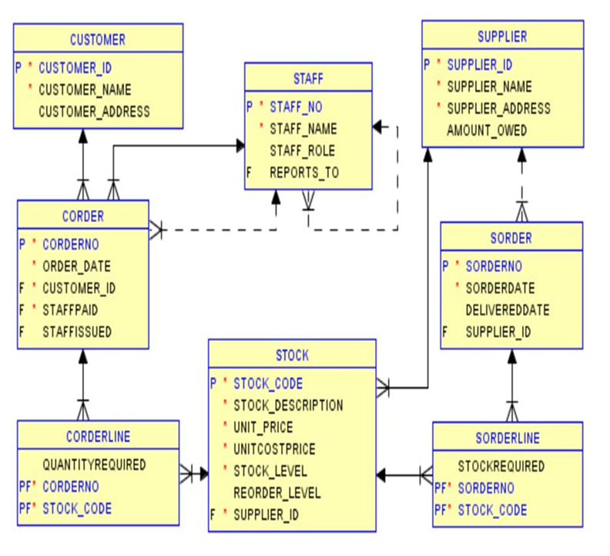
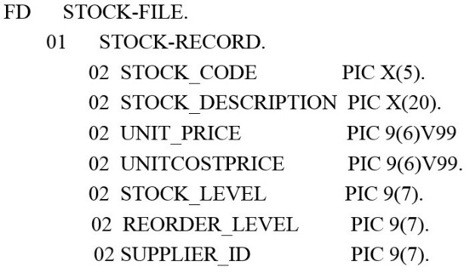
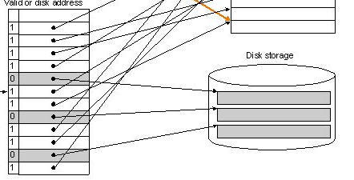
Schemas
External views
What does the foreman need?
The customer?
The salesperson?
Concepts – the ERD
Internal
Like a file descriptor in C
Physical
The data address on disk

Slide 7
Features of a relational database
Integrity
Referential Integrity
Data Independence
Controlled Redundancy
Security / Privacy

Slide 8
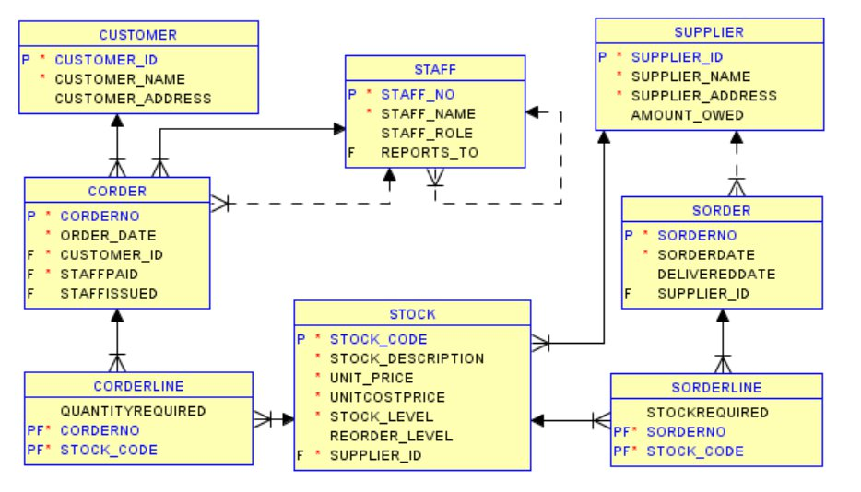
The strengths of RDB
Strengths
Different views allow it to fulfil the needs of all users.
It avoids
Insert
Update and
Delete anomalies
It provides 2 of the three CAP principles
Consistency, Availability, Partition tolerance

Slide 9
Weakness of RDB
RDBMS
High-value, high-density, complex data
Complex data relationships
Joins
Schema-centric
Designed to scale up, not out
Well-defined standards

Slide 10
